Slide 1
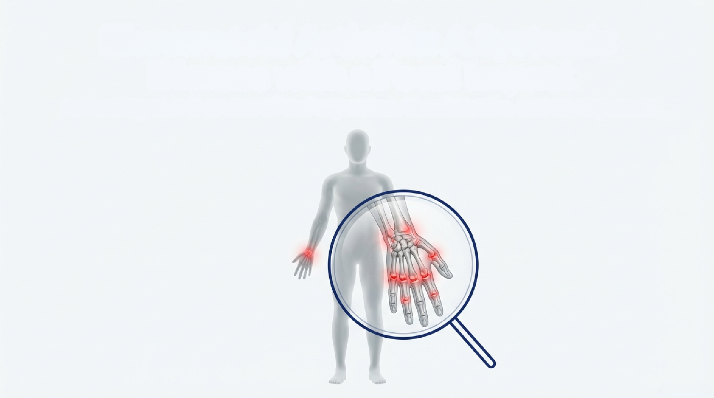
Rheumatoid Arthritis: A Systemic Disease with a Focal Impact
prepared by :
Name : ahed bseiso Student No.:

Slide 2
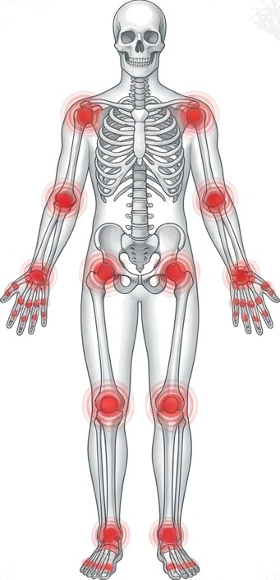
A Chronic, Systemic Autoimmune Condition
Rheumatoid Arthritis (RH) is a chronic, systemic, autoimmune inflammatory disease that primarily affects synovial joints.
It is characterized by persistent joint inflammation, progressive joint destruction, deformities, and functional disability.
While commonly involving the small joints of the hands and wrists, it may also have
extra-articular manifestations.

Slide 3




Slide 4
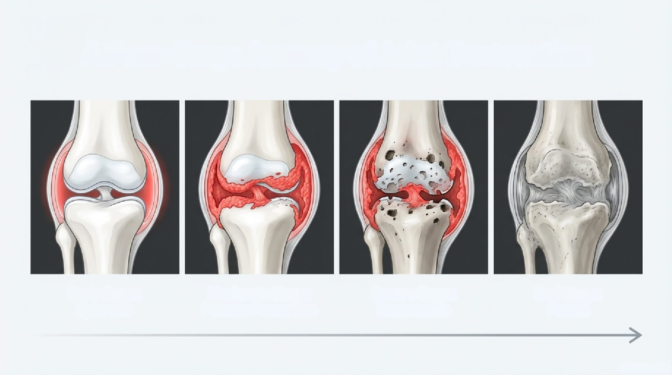
A Four-Stage Journey of Joint Destruction
Early Stage: Synovitis
Moderate Stage: Pannus Formation
Severe Stage: Destruction
End Stage: Fusion

Slide 5
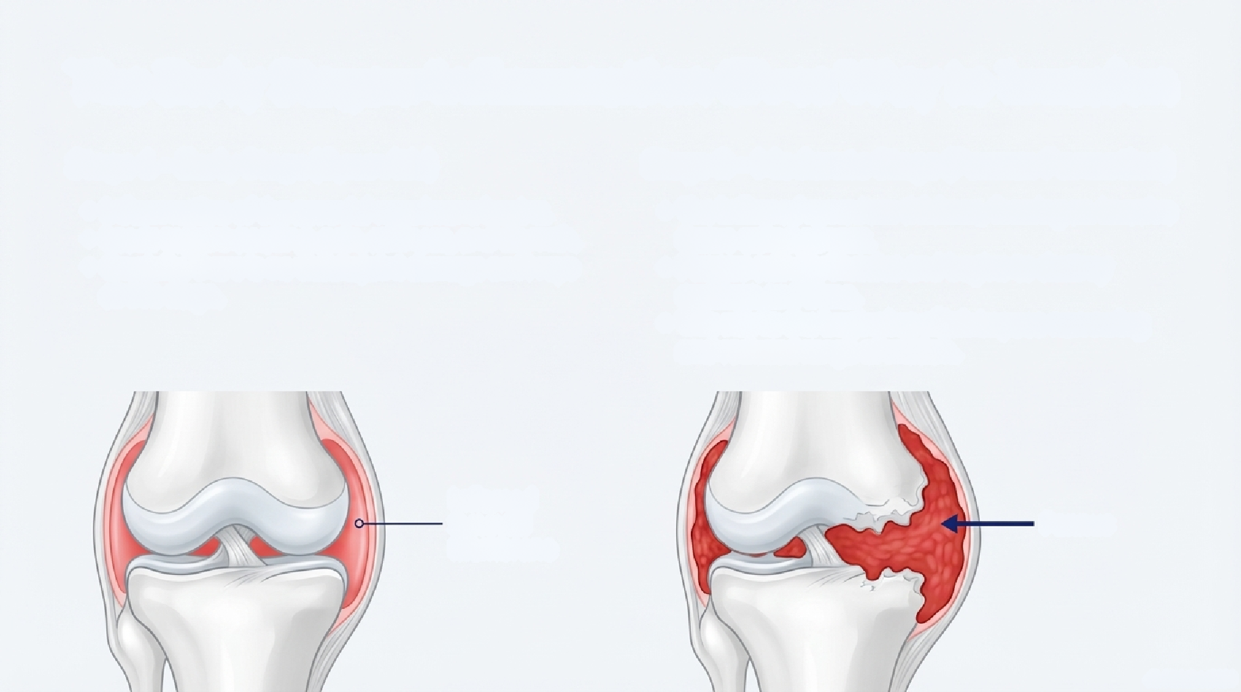
The Early Stages: Inflammation Gives Way to Invasion
Stage 1 - Early Stage (Synovitis)
Inflammation of the synovial membrane begins.
Leads to joint swelling, pain, stiffness, and warmth. Crucially, there is no visible joint damage on X-rays at this stage.
Stage 2 - Moderate Stage (Pannus Formation)
The inflamed synovium thickens, forming an invasive tissue called pannus.
Pannus actively invades and begins to destroy cartilage and bone.
This marks the beginning of joint space narrowing
and reduced range of motion.
Inflamed Synovial
Membrane
P a n n u s

Slide 6
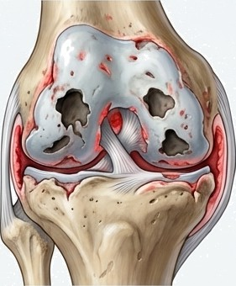
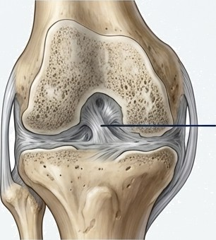
The Late Stoges: From Severe Destruction to Functional Loss
Stage 3 Severe Stage
Significant destruction of cartilage and bone is now
"^{V}'^{de}F’^{t}'
Joint deformities develop as a result of structural
collapse and tendon imbalance,
Marked functional limitations and muscle weakness are common.
Stage 4 End Stage
Active inflammation often decreases.
The disease ”burns out,” but leaves behind fused
(ankylosed) or fibrotic joints.
The result is severe deformities and a profound loss
of joint function.
Ankylosis

Slide 7
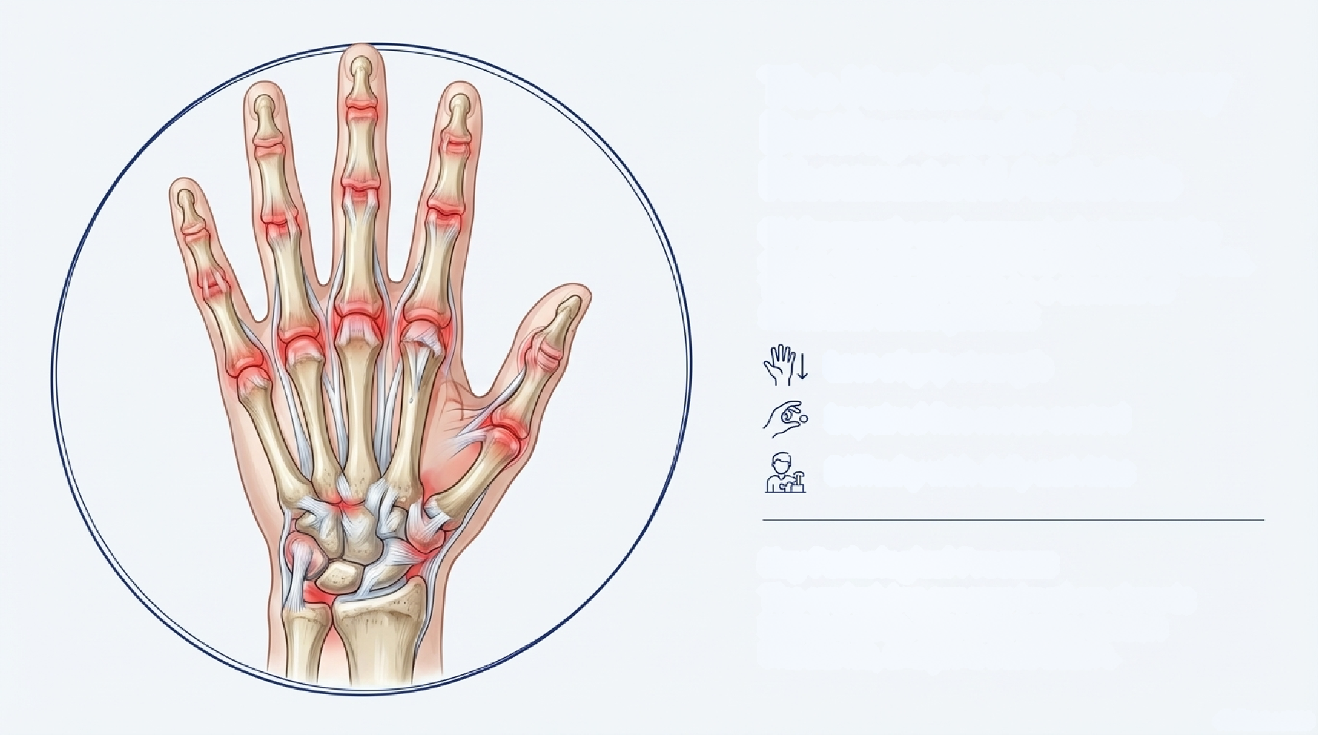
The Hands: The Primary Battleground of Rheumatoid Arthritis
RH frequently and aggressively targets the small, complex joints of the hands and wrists. This focal impact leads to a cascade of functional consequences:
Loss of grip strength Impaired fine motor control Difficulty with daily activities
Key Pathological Process:
The underlying process involves chronic inflammation, ligament laxity, tendon imbalance, and joint destruction.

Slide 8
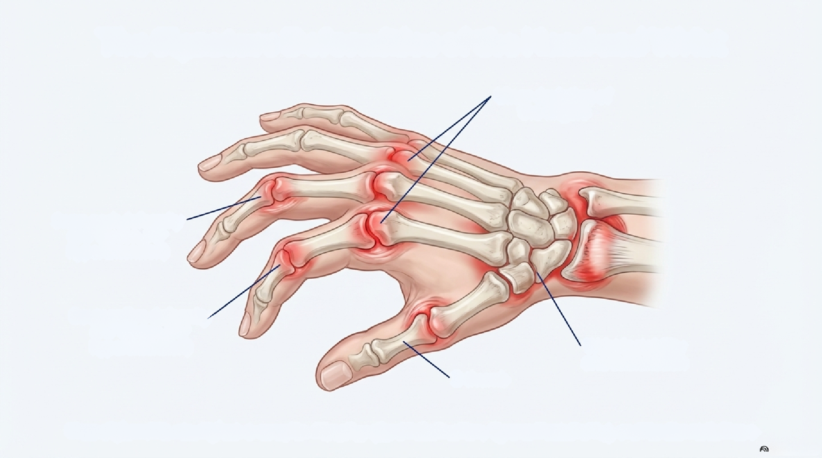
The Signature Deformities of the Hand and Wrist
Ulnar deviation of the fingers
Swan-neck deformity (DIP flexion, PIP hyperextension)
Boutonnière deformity (PIP flexion, DIP hyperextension)
Wrist instability and subluxation
Z- thumb
These deformities result from a complex interplay of joint destruction, ligament weakening, and tendon imbalance.

Slide 9









The Pathological Cascade Within the Hand
The progressive loss of hand function and dexterity is driven by a predictable sequence of tissue damage.
Synovial Membrane Inflammation
Pannus Formation
Destruction of joint Surfaces Ligament and Tendon Weakening joint Subluxation and Deformity

Slide 10





Effective Management of Rheumatoid Arthritis (RA)
Requires a comprehensive and integrated strategy
Aims to control disease activity and preserve functional ability
Medical therapy : Suppresses inflammation Halts or slows disease progression
Prevents joint destruction
Rehabilitative interventions : Maintain joint mobility Improve muscle strength Preserve function
Enhance quality of life
Surgical management : Indicated in advanced disease
Used when irreversible joint damage impairs function
Aims to relieve pain and restore function

Slide 11


The Pillars of Management: Medication and Rehabilitation
Medical Treatment
Rehabilitation Treatment
Goal: To control inflammation, slow disease progression, and manage pain.
Key Drug Classes:
Disease-Modifying Antirheumatic Drugs (DMARDs)
Biological Agents
Nonsteroidal Anti-inflammatory Drugs (NSAIDs)
Corticosteroids
Goal: To protect joints, improve function, and maintain quality of life.
Key Interventions:
Physical Therapy
Occupational Therapy
joint protection techniques
Prescribed hand exercises

Slide 12
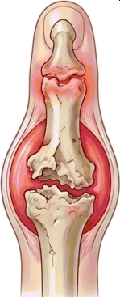
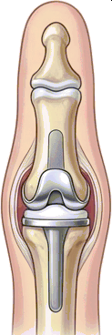

Surgical Interventions for Advanced Joint
Destruction
In advanced stages of RH, when joint damage is severe and causes significant pain or functional loss, surgical options may be considered to restore stability and function.
Severely Damaged
Joint
Joint Replacement (Arthroplasty)
Key Surgical Procedures:
Synovectomy: Removal of the inflamed synovial membrane.
Tendon Repair: Surgical correction of ruptured
or damaged tendons.
joint Fusion (Arthrodesis): Fusing bones together to provide stability and relieve pain, sacrificing motion.
joint Replacement (Arthroplasty): Replacing
the damaged joint with a prosthesis.
Severely Damaged
Joint
Joint Replacement (Arthroplasty)

Slide 13
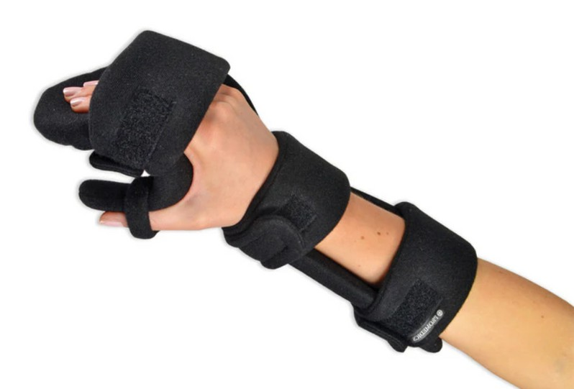


Wrist Splints
Most commonly prescribed splints in RA
Indications:
Wrist synovitis Pain and instability
Reduced grip strength
Functions:
Maintain the wrist in a functional position Reduce stress on inflamed joints
Improve hand function and grip
Types:
Resting wrist splints (used during flare-ups) Functional wrist splints (used during activities)

Slide 14

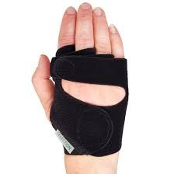

Hand and Finger Splints
Ulnar Deviation Splints
Indications:
Ulnar drift of the fingers at the MCP joints
Functions:
Correct or prevent ulnar deviation Improve finger alignment Enhance hand function
Ring Splints
Indications:
Early or established finger deformities
Functions:
Provide joint alignment Allow controlled movement Prevent worsening deformity

Slide 15
conclusion
Rheumatoid Arthritis is a progressive, systemic disease with a profound focal impact, particularly on the hands. While there is no cure, a deep understanding of its pathological process allows for a targeted, multidisciplinary approach.
Through a combination of advanced medical treatments, dedicated rehabilitation, and supportive devices, the goals are to control disease activity, manage symptoms, slow the progression of joint destruction, and ultimately preserve function and quality of life.

Slide 16
THANK YOU

